Slide 1
Creating a Dublin Core Record in Oxygen
Metadata in Theory & Practice

Slide 2
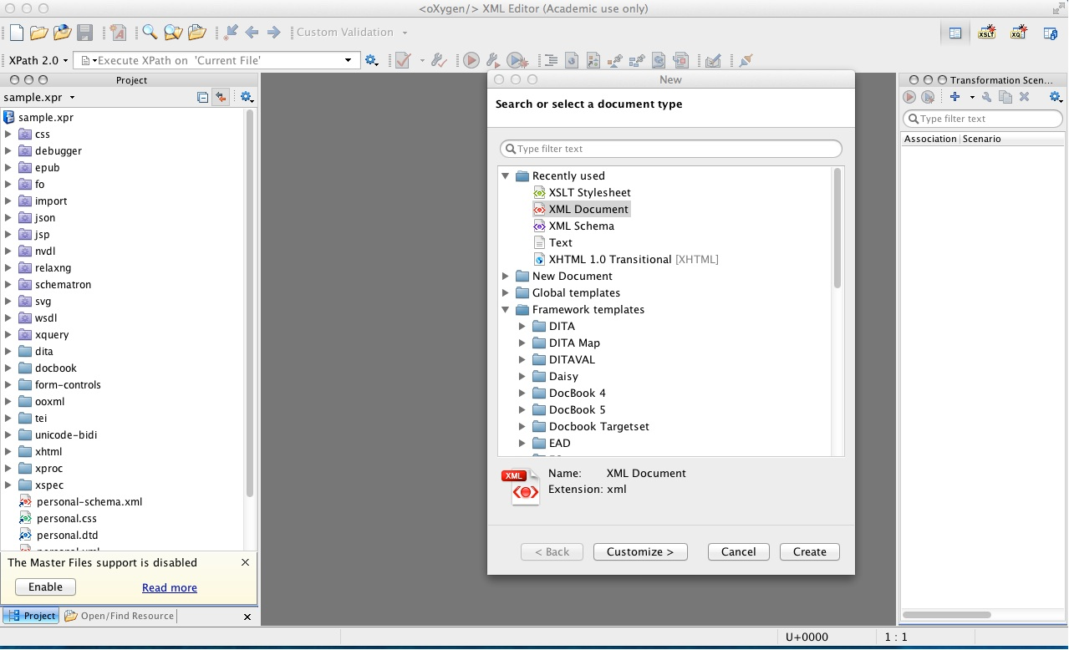
Starting a new XML file
Notes:
When you start Oxygen for the first time, you should have a blank, dark grey pane (possibly flanked by some control panes). Going to the “File” menu option and selecting “New” will call up the above pop-up window which allows you to specify what sort of document you want to create. Click on “XML Document”, and then click on the “Customize” button at the bottom of the pop-up. This will call up another pop-up you’ll see on the next slide.

Slide 3
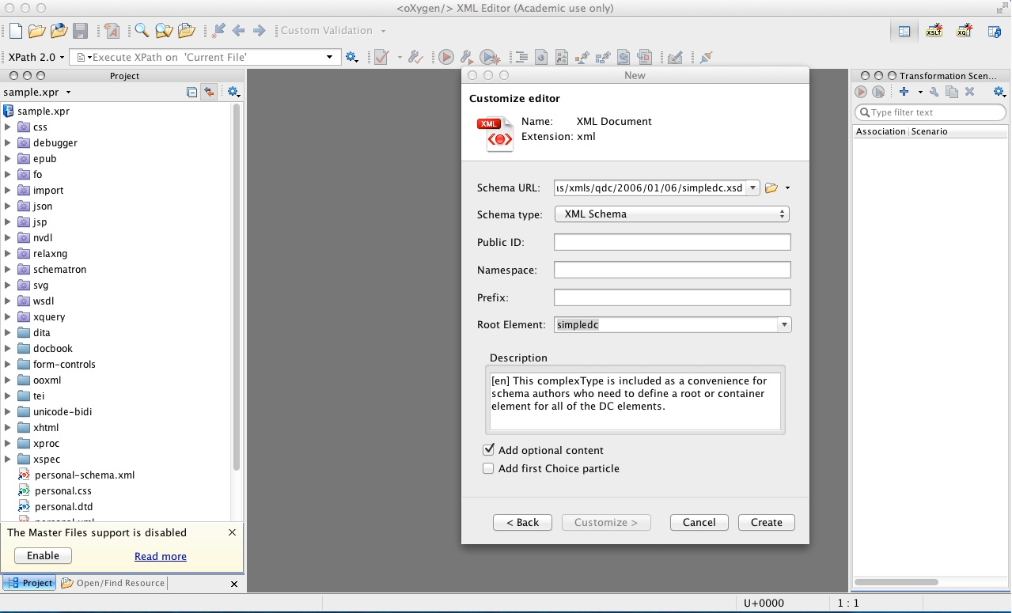
Specifying an XML Schema and Root Element
Notes:
Schema files tell Oxygen what elements and attributes can appear in a particular class of XML documents. Generally, schema files are kept on the web so that people can all rely on the same copy of a schema. In the first text entry field, you need to enter the URL for Dublin Core Container Schema file (http://dublincore.org/schemas/xmls/qdc/2006/01/06/simpledc.xsd). When you have done so, hit the Tab key (NOT the return key). Oxygen will read the Schema file from the web, and then alter this window so that the “Root Element:” box has a drop down list of acceptable root elements for this schema. It may also supply a “Prefix” value. In the Root Element drop down list, select “simpledc” and then click on the “Create” button at the bottom of the pop-up window.

Slide 4
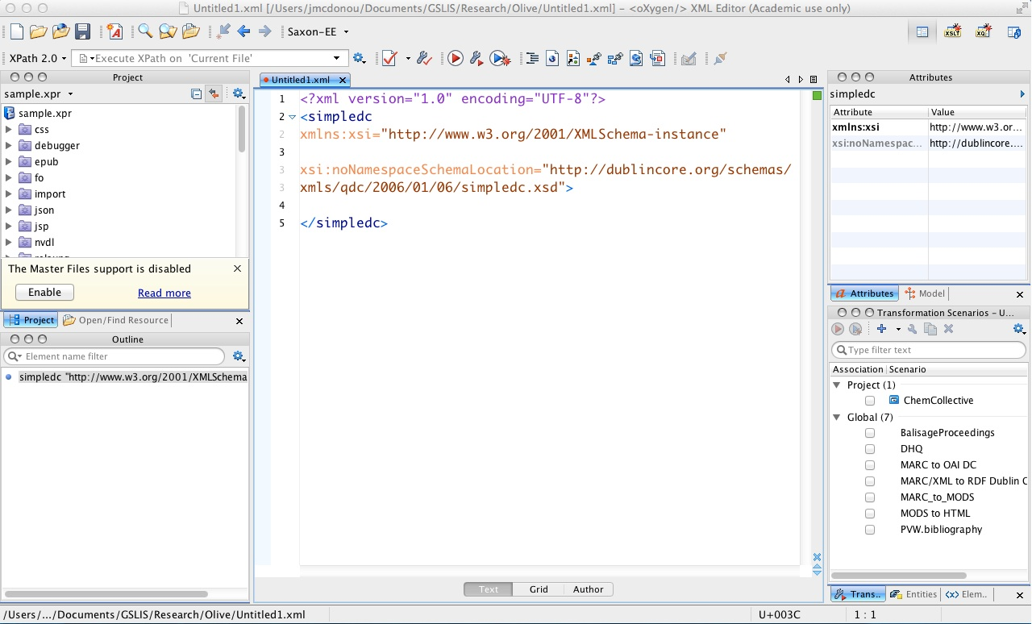
Starting to edit an XML file
Notes:
You should now see something like this, a basic Dublin Core XML file waiting to be edited. Note the green box in the top of the scroll bar (by the teal arrow); this is an indication that this document is valid, that is, it currently conforms with the Dublin Core XML Schema File’s restrictions on elements and attributes.

Slide 5
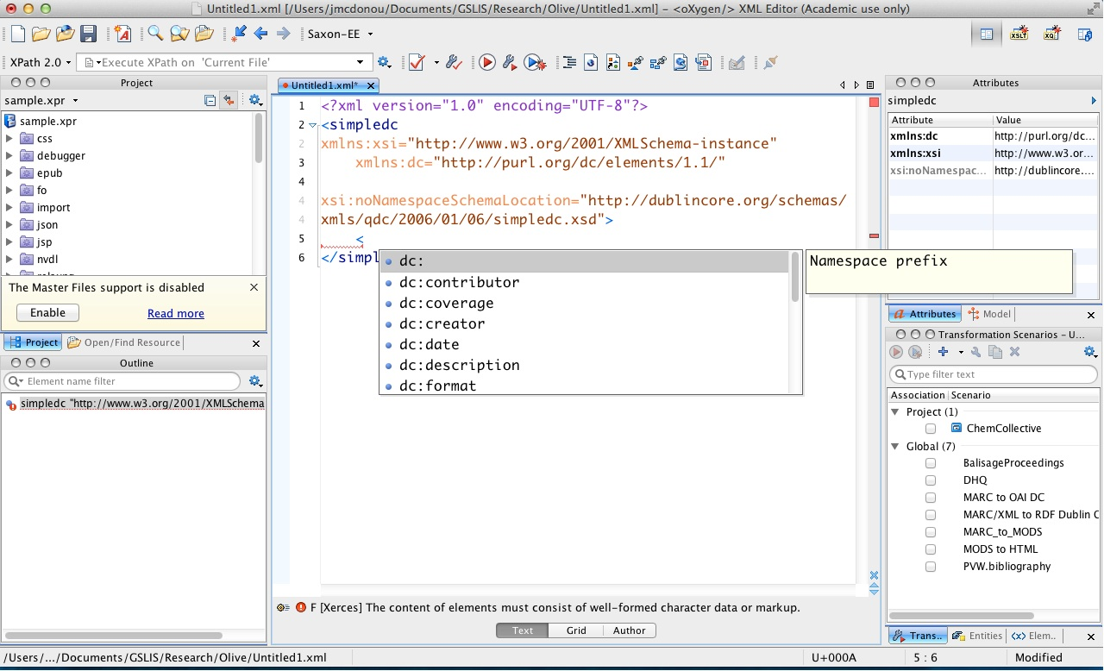
Adding a namespace prefix
Notes:
The root element for this document has a name of <simpledc> you will recall. The root element for an XML document may specify namespace prefixes to be used in a document; you can think of namespace prefixes as a convenient means of insuring that elements from different XML schema don’t conflict with one another. While we are only using one schema in this XML document, the schema itself actually specifies that the Dublin Core elements are all in a particular namespace which has a URI assigned to it: http://purl.org/dc/elements/1.1/
Note that in the root element we have added a new line (at the red arrow) saying: xmlns:dc=“http://purl.org/dc/elements/1.1/”
This is a namespace prefix declaration. The “xmlns:” lets Oxygen know we are declaring a namespace prefix, and “dc” is the actual prefix value. The “=http://purl.org/dc/elements/1/1” lets Oxygen know which specific namespace is using the “dc” prefix.
Having added that namespace prefix declaration, we can now start adding elements to our document. If you go to the blank line between the <simpledc> start and end tags (indicated by the green arrow) and type a “<“ to start a new start tag, Oxygen should provide you with a drop-down list of elements you can legally insert at this point in your document. Just scroll down and click on the element you want to add.

Slide 6
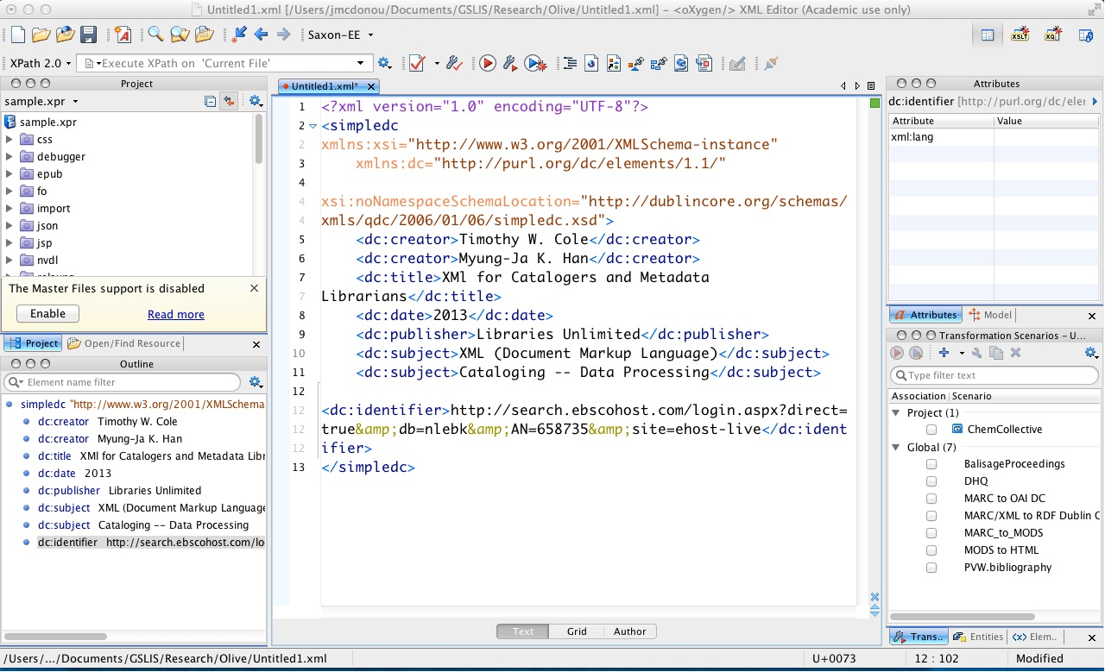
A finished Dublin Core Document
Notes:
Here’s what a Dublin Core document looks like after we’ve added several new elements and their contents. Note that the box in the scroll bar is still green, indicating our document is valid (if it wasn’t, that box would be red). Go the “File” menu and click on “Save” to save your document.

Slide 7
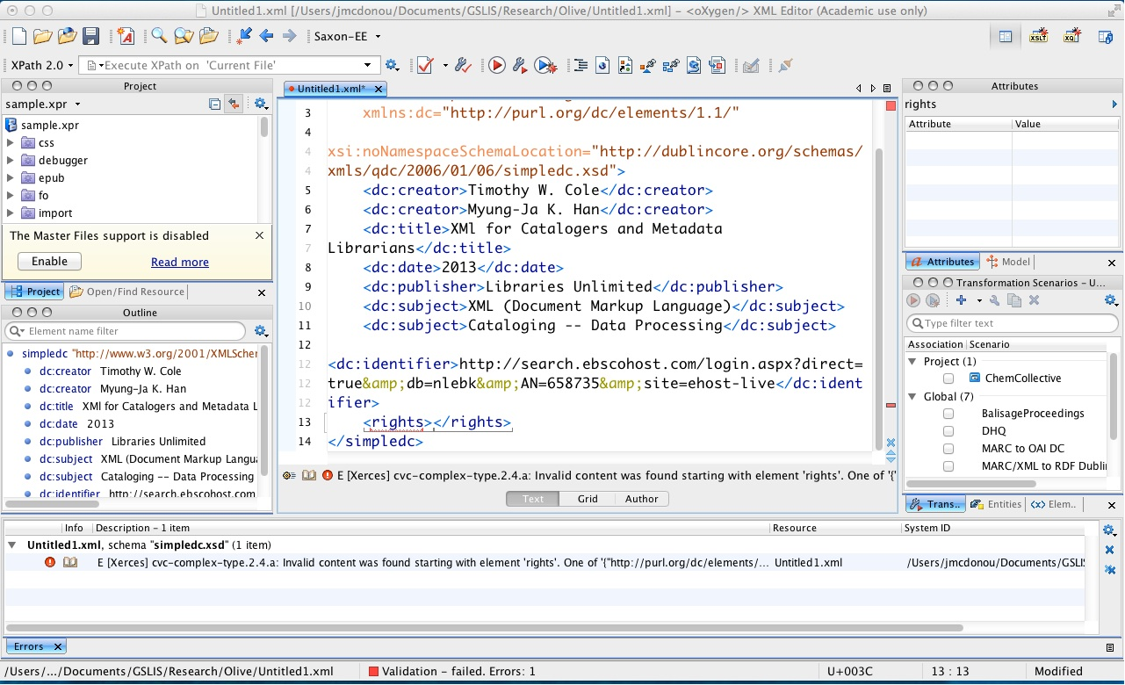
When things head south….
Notes:
If you’re seeing a red square at the top of the scroll bar when you’re finished editing a document, it’s an indicator that your document isn’t valid. To learn more about why, click on the validation button on the Oxygen tool bar (the page with a red check icon, indicated by the red arrow above). This will validate your document against the appropriate XML schema, and provide a list of validation errors at the bottom of your window. The error message in this case:
“Invalid content was found starting with element ‘rights’. One of ‘{“http://purl.org/dc/elements/1.1/”:any}’ is expected.”
Is telling you that the element <rights> isn’t legal at this point in your document, and that the XML parser was expecting something different. Specifically, it was expecting any element in the http://purl.org/dc/elements/1.1/ namespace. If you look at the document, you’ll notice that I’ve neglected to put in the “dc:” namespace prefix on the <rights> element, so the parser is (quite rightly) complaining about a non-Dublin Core namespace date element appearing in a Dublin Core document. Simply putting in “dc:” before “rights” on the <rights> start and end tags will fix the problem.
Unless you have been editing XML for awhile (and some times even when you *have* been editing XML for awhile), Oxygen’s validation error messages can seem a bit cryptic. Please post to the technical forum if you need help deciphering Oxygen’s messages.
A word of advice in fixing problems. Fix your validation errors starting from the beginning of your documents and working towards the end. Some times a validation problem early on in a document can confuse the parser and make it believe you have problems later on in your document when you really don’t. I’ve often had a situation where fixing one validation problem at the beginning of an XML document made 20 other validation errors simply vanish.

